Slide 1

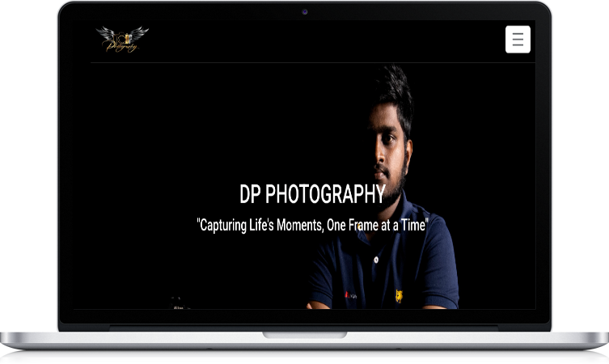
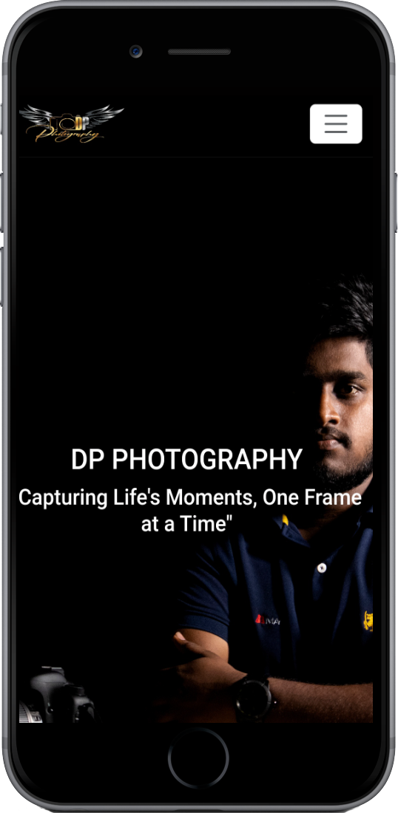
Website for dp photography
W.L.H.S.Thilakasiri
DEH/IT/2022/F/0045

Slide 2
INTRODUCTON
What is Photography?
About DP Photography
W.L.H.S.Thilakasiri
DEH/IT/2022/F/0045

Slide 3
PROBLEMS
Social media is not enough for promote a brand
Need of Portfolio
Reach to new customers
W.L.H.S.Thilakasiri
DEH/IT/2022/F/0045

Slide 4
SOLUTION
Introduce a Website
W.L.H.S.Thilakasiri
DEH/IT/2022/F/0045

Slide 5
CONCLUTION
All Information in one place
Get customer attraction
User friendly design
Mobile responsive
Static website
W.L.H.S.Thilakasiri
DEH/IT/2022/F/0045

Slide 6
THANKS.
W.L.H.S.Thilakasiri
DEH/IT/2022/F/0045

